Slide 1
Software Quality Engineering
Lecture 1
software testing
Alina Arshad
alina.arshad@nu.edu.pk

Slide 2
EQUIVALENCE CLASS TESTING
A large number of test cases are generated for any program. It is neither feasible nor desirable to execute all such test cases.
Divide input domain into various categories with some relationship and expect that every test case from a category exhibits the same behavior.
If categories are well selected, we may assume that if one representative test case works correctly, others may also give the same results..
Each category is called an equivalence class and this type of testing is known as equivalence class testing.
Notes:
Many test cases do not test any new thing and they just execute the same lines of source code again and again.

Slide 3
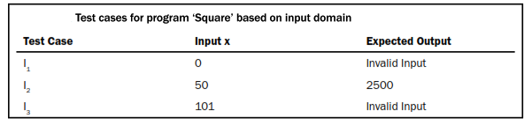

Creation of Equivalence Classes
The entire input domain can be divided into at least two equivalence classes: one containing all valid inputs and the other containing all invalid inputs.
Each equivalence class can further be sub-divided into equivalence classes on which the program is required to behave differently.
Square program

Slide 4
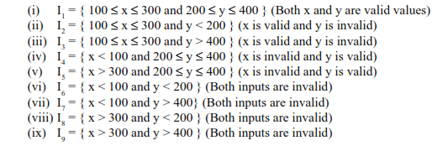
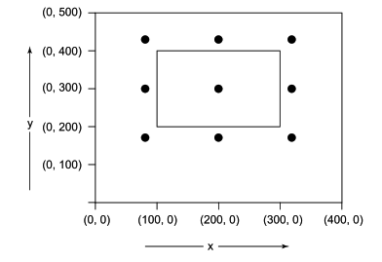
Equivalence classes for addition program

Slide 5
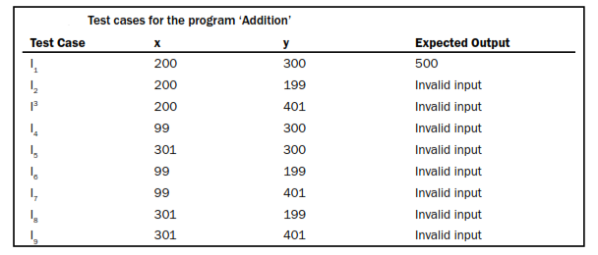
Test cases for addition

Slide 6
applicability
Applicable at unit, integration, system and acceptance test levels.
The basic requirement is that inputs or outputs must be partitioned based on the requirements and every partition will give a test case.
If one test case catches a bug, the other probably will too.
The design of equivalence classes is subjective to testing person.

Slide 7
Example
Consider a program for the determination of the largest amongst three numbers. Its input is a triple of positive integers (say x, y and z) and values are from interval [1, 300].
Design the equivalence classes

Slide 8
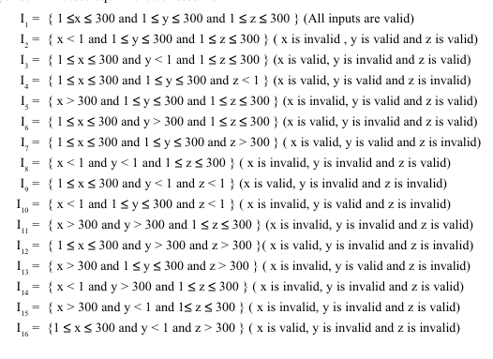
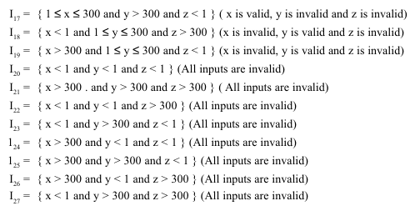

Slide 9
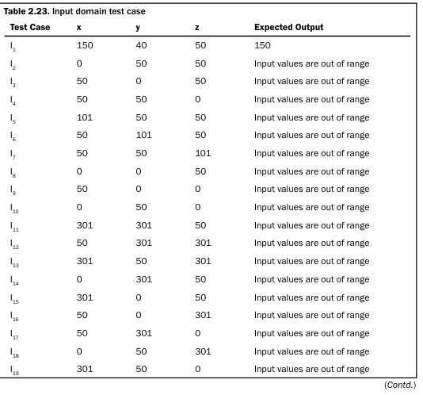

Slide 10
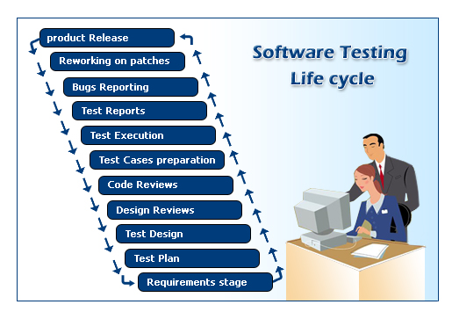
Software Testing Life Cycle

Slide 11
Software Testing Life Cycle
STLC consists of six (generic) phases which are as follows:
Test Planning
Test Analysis
Test Design
Test Cases Preparation
Testing Cycles
Post Implementation
Notes:
What is software Testing? (Recap)

Slide 12
STLC – Test Planning
This is the phase where Project Manager has to decide what things need to be tested, do I have the appropriate budget etc.
The Software Test Plan (STP) is designed to prescribe the scope, approach, resources, and schedule of all testing activities.

Slide 13
STLC – Test Planning (Cont..)
The plan must identify:
the items to be tested
the features to be tested
the types of testing to be performed
the personnel responsible for testing
the resources and schedule required to complete testing
the risks associated with the plan

Slide 14
STLC – Test Analysis
Once test plan is made and decided upon, next step is to delve little more into the project and decide what types of testing should be carried out at different stages of SDLC.
Proper and regular meetings should be held between testing teams, project managers, development teams, Business Analysts to check the progress of things which will give a fair idea of the movement of the project and ensure the completeness of the test plan created in the planning phase.

Slide 15
STLC – Test Design
Test plans and cases which were developed in the analysis phase are revised.
If you have thought of automation then you have to select which test cases to automate and begin writing scripts for them.
Test data is prepared.
Standards for unit testing and pass / fail criteria are defined here.
Schedule for testing is revised (if necessary) & finalized and test environment is prepared.

Slide 16
STLC – Test Cases Preparation
In this phase, test cases are prepared.
(We will be preparing test cases as a class activity later………)

Slide 17
STLC – Testing Cycles
In this phase we have to complete testing cycles until test cases are executed without errors or a predefined condition is reached.
Run test cases --> Report Bugs --> revise test cases (if needed) --> add new test cases (if needed) --> bug fixing --> retesting (test cycle 2, test cycle 3….).

Slide 18
STLC – Post Implementation
In this phase, the testing process is evaluated and lessons learnt from that testing process are documented.
Line of attack to prevent similar problems in future projects is identified.

Slide 19
Any question????

